Slide 1


U.ST GLOBAL BANK
Project Guide : Purushotham
Presented by: [SYNTAX SQUARD]

Slide 2
Problem Statement/Overview
• Manual banking processes are time-consuming and error-prone.
• Lack of predictive tools for decision-making in finance.
• Need for secure, efficient, and scalable banking solutions.

Slide 3
Solution Overview
• Web-based system using Django for banking operations.
• Secure user authentication and role-based access.
• Machine Learning for fraud detection or credit analysis.

Slide 4

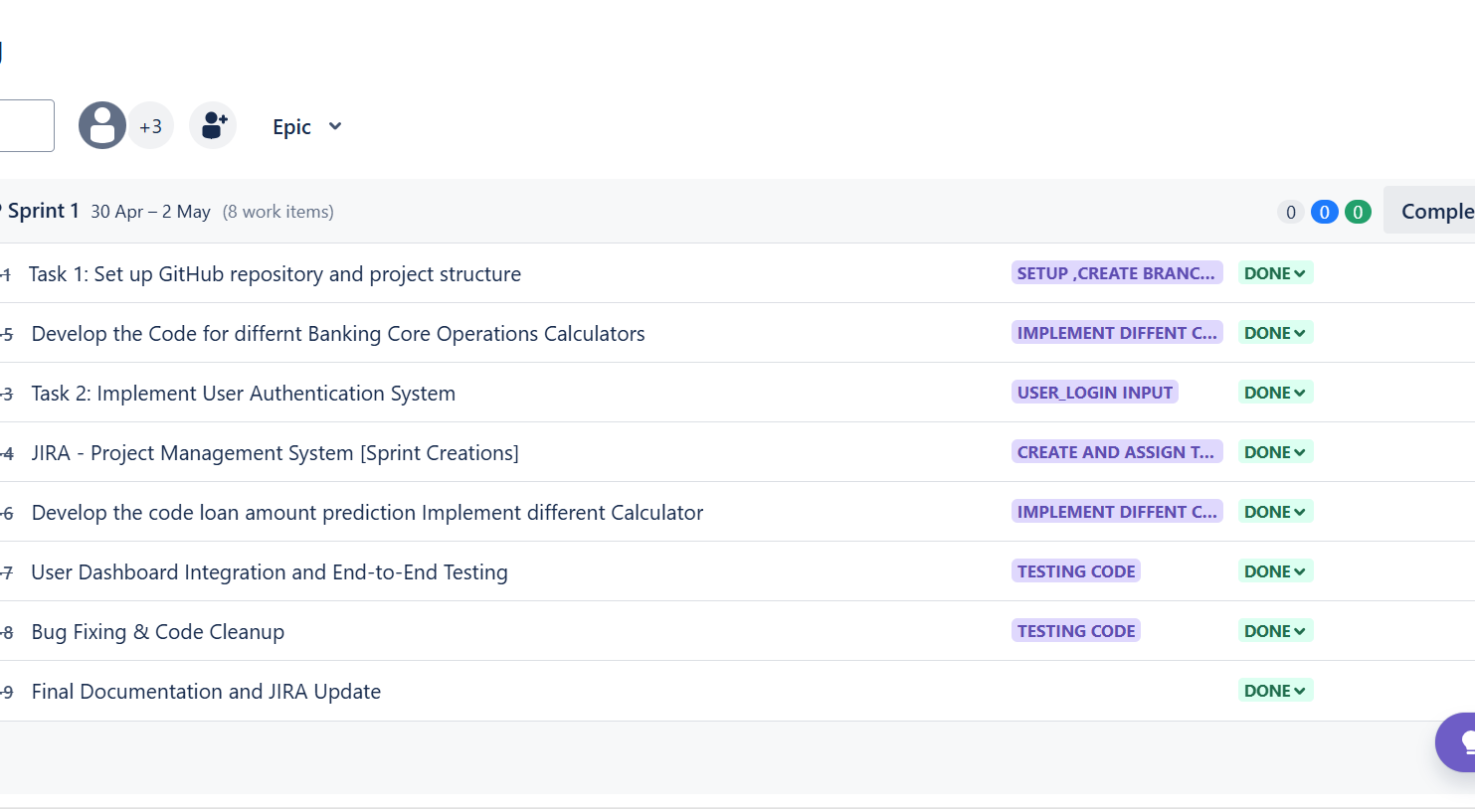



Project management : JIRA

Slide 5
Key Features
• User authentication and dashboard
• Transaction and account management
• Predictive analytics using ML
• Admin control panel

Slide 6
Live Demo Highlights
• Secure Login & Role Access
• Dynamic Dashboards
• Transaction Management
• Prediction Output with Insights
Achievements & Learning
• Integrated ML into production-ready web app
• Ensured secure authentication & role control
• Streamlined transactions & UI design
• Gained full-stack development and ML deployment experience

Slide 7
System Architecture
• Django MVC Framework (Model-View-Controller)
• SQLite for database management
• Scikit-learn for ML integration
• Template-based frontend with HTML/CSS/JS

Slide 8
Security Features
🔐 Password hashing (Django auth)
🔐 Input validation & CSRF protection
🔐 Session management
🔐 Admin authentication for control

Slide 9
Financial Calculators
1. EMI Calculator
2. Fixed Deposit (FD) Calculator
3. Recurring Deposit (RD) Calculator
4. Simple Interest
5. Compound Interest
6. SIP (Systematic Investment Plan)
7. PPF
8. Retirement
9. Education Planning
10. Loan Repayment

Slide 10
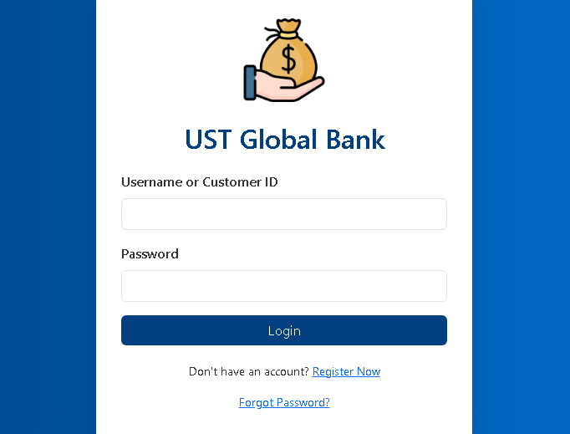
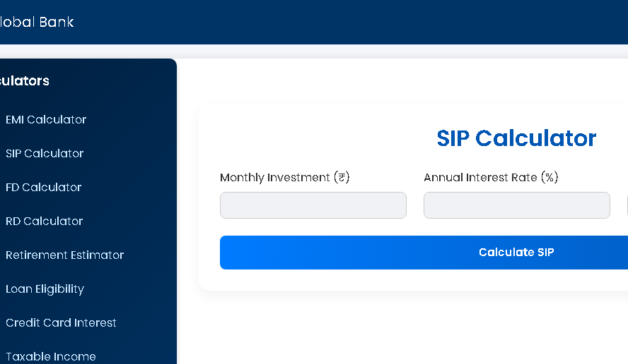
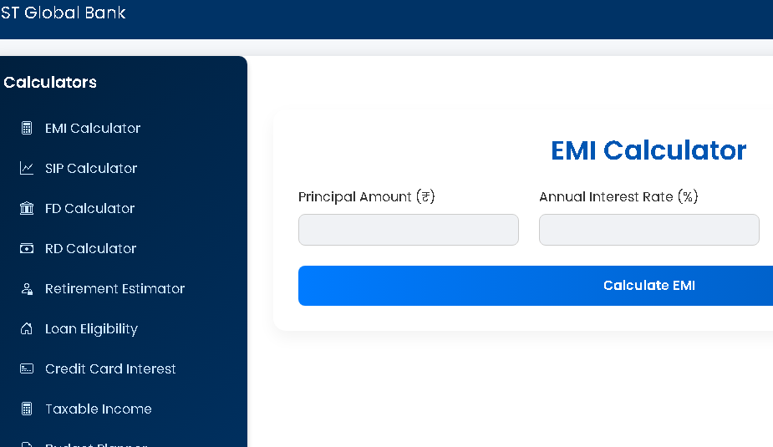
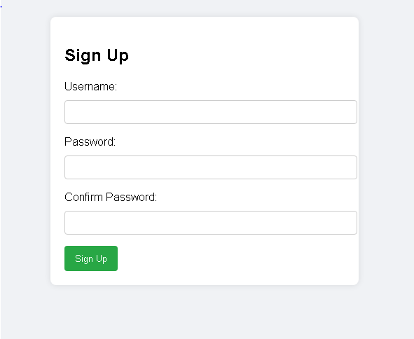

Slide 11

Machine Learning Integration
• ML module in `predict.py`
• Uses model to predict financial behaviors
• Potential applications: loan predication.
• Inputs: user financial data, Outputs: predictions

Slide 12
Machine Learning Model
Model: Linear Regression
Metrics:
Mean Absolute Error: 13259.887823345072
Mean Squared Error: 268044207.85729995
R² Score: 0.29715025023167274
System Architecture
1. User submits form
2. Django reads input
3. Model predicts using .pkl file
4. Result displayed to user

Slide 13
Advantages & Improvements
Fast & Accurate: Provides instant loan estimates using trained ML model.
Insights with EDA: Visualizations help understand loan trends.
Pre-Eligibility Checks: Customers can check loan eligibility before applying, reducing rejections.
Faster Loan Processing: Banks save time by pre-filtering applicants with automated estimates.
Improvements
Model Comparison Page: Let users view predictions from multiple models.

Slide 14
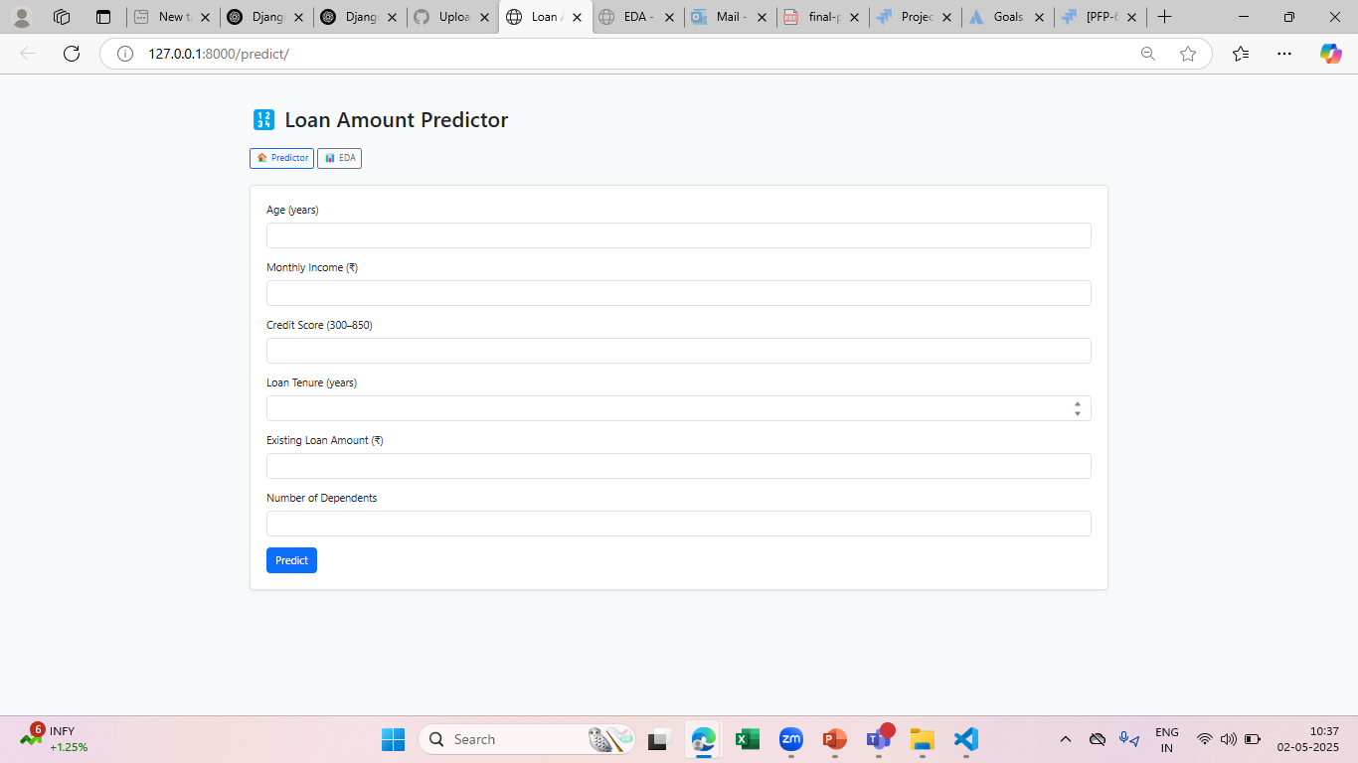
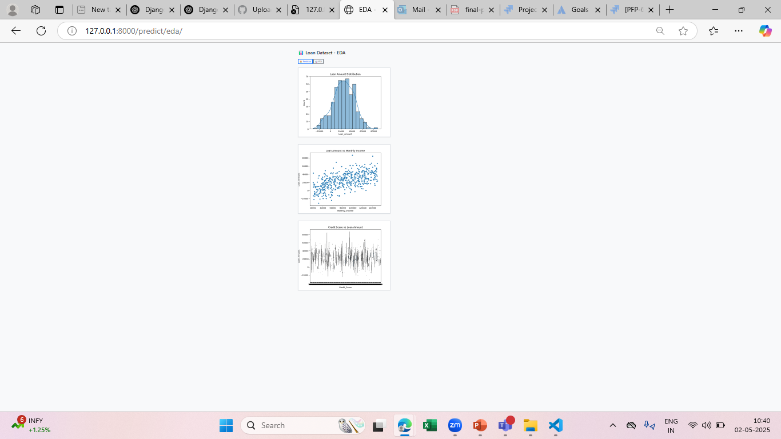
Web Interface
Web Interface →Loan Amount predictor And EDA

Slide 15
Challenges & Learnings
• Integrating ML with Django backend
• Ensuring security for user data
• Learned full-stack development using Django
• Gained insights into model deployment

Slide 16
Future Enhancements
• API development for third-party integration
• Deployment to cloud (AWS, Heroku)
• Real-time analytics and visualizations
• Switch to PostgreSQL for scalability

